Slide 1

TOPIC: Digital Transmission
NAME : Arkapratim Ghosh
Roll No. : 13000121058
Registration No. : 211300100110045
Paper Name: Computer Networks
Paper Code: PCC-CS602
CSE, Sec-A, 6th Sem (2021-2025), CA-1

Slide 2

CONTENT
Introduction
Digital to Digital Conversion
Line Coding
Block Coding
Scrambling
Analog to Digital Conversion
Pulse Code Modulation
Delta Modulation
Transmission Modes
Parallel Transmission
Serial Transmission
Conclusion
Reference

Slide 3
INTRODUCTION
A computer network is designed to send information from one point to another. This information needs to be converted to either a digital signal or an analog signal for transmission
There are two schemes -
Digital-to-Digital conversion techniques : methods which convert digital data to digital signals.
Analog-to-digital conversion techniques : methods which change an analog signal to a digital signal

Slide 4
DIGITAL TO DIGITAL CONVERSION
Data can be either digital or analog.
Signals that represent data can also be digital or analog.
We can represent digital data by using digital signals.
The conversion involves three techniques: line coding, block coding, and scrambling.
Line coding is always needed; block coding and scrambling may or may not be needed

Slide 5
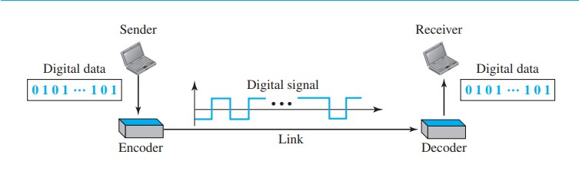
LINE CODING
Line coding converts a sequence of bits to a digital signal. At the sender, digital data are encoded into a digital signal; at the receiver, the digital data are recreated by decoding the digital signal.
A data element is the smallest entity that can represent a piece of information: this is the bit.
A signal element is the shortest unit (timewise) of a digital signal.

Slide 6
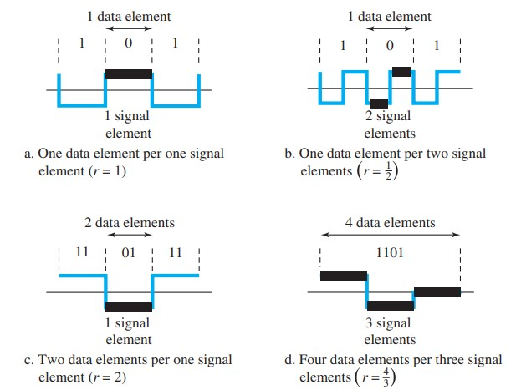
LINE CODING (CONTINUED)
Data Rate Versus Signal Rate
The data rate (N) defines the number of data elements (bits) sent in 1s. The unit is bits per second (bps). The data rate is sometimes called the bit rate.
The signal rate (S) is the number of signal elements sent in 1s. The unit is the baud.; the signal rate is sometimes called the pulse rate, the modulation rate, or the baud rate.
S = N / r
r is the number of data elements carried by each signal element
S_{ave} = c * N * (1/r) baud
c is the case factor

Slide 7
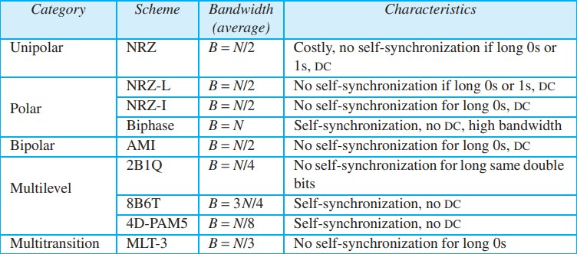
LINE CODING (CONTINUED)
Line Coding Schemes

Slide 8
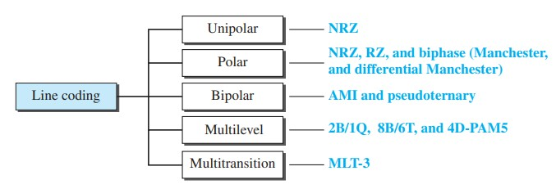
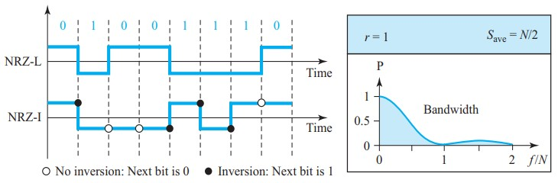
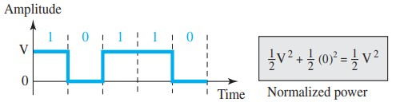
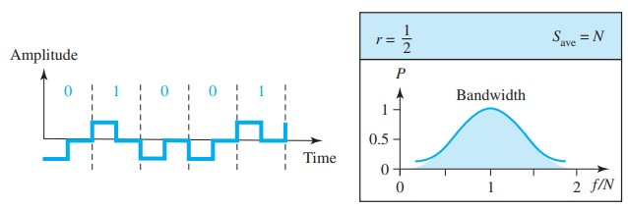
LINE CODING (CONTINUED)
Polar NRZ-L and NRZ-I schemes
Unipolar NRZ scheme
Polar RZ scheme

Slide 9
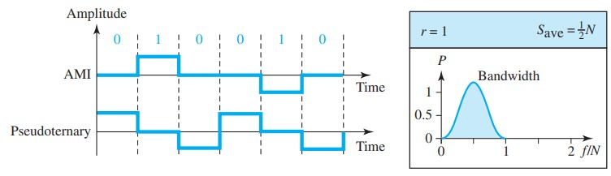
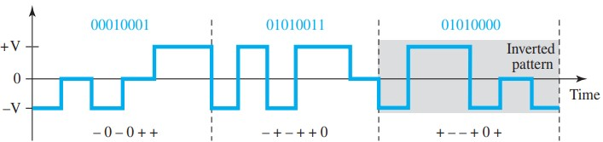
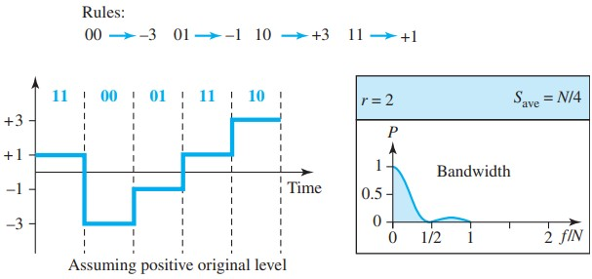
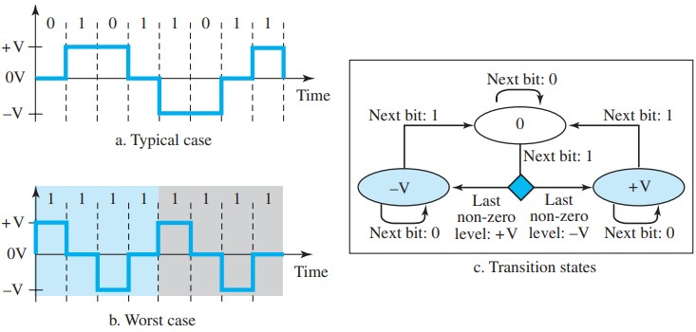
LINE CODING (CONTINUED)
Bipolar schemes: AMI and pseudoternary
Multilevel: 8B6T scheme
Multilevel: 2B1Q scheme
Multi Transition: MLT-3 scheme

Slide 10
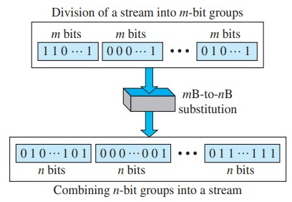
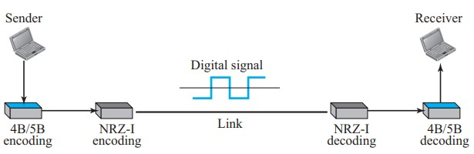
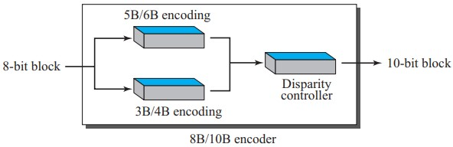
BLOCK CODING
Block coding changes a block of m bits into a block of n bits, where n is larger than m. Block coding is referred to as an mB/nB encoding technique
4B/5B CODING SCHEME
BLOCK CODING CONCEPT
8B/10B CODING SCHEME

Slide 11
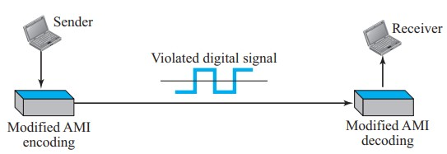
SCRAMBLING
Biphase schemes are suitable for LANs but not for long-distance communication due to wide bandwidth requirements.
Block coding combined with NRZ line coding is not suitable for long-distance encoding due to the DC component.
Bipolar AMI encoding is narrow-bandwidth and lacks a DC component but faces synchronization issues with long 0 sequences.
Scrambling is a technique to avoid long 0 sequences in bipolar AMI encoding for long-distance communication.
B8ZS and HDB3 are common scrambling techniques used for this purpose.
AMI used with scrambling

Slide 12
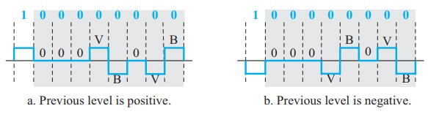
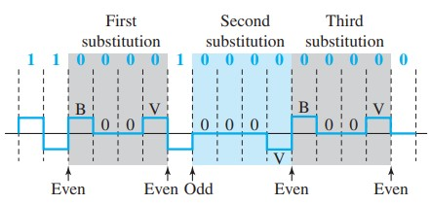
SCRAMBLING (continued)
Two cases of B8ZS scrambling technique B8ZS substitutes eight consecutive zeros with 000VB0VB.
Different situations in HDB3 scrambling technique
HDB3 substitutes four consecutive zeros with 000V or B00V depending on the number of nonzero pulses after the last substitution.

Slide 13
ANALOG TO DIGITAL TRANSMISSION
Analog to digital transmission converts continuous analog signals into discrete digital data.
It involves sampling, quantization, and encoding to represent analog information in digital form.
This process is crucial for efficient and reliable communication in digital systems.
The resulting digital signal can be easily processed, transmitted, and reconstructed at the receiving end.

Slide 14
PULSE CODE MODULATION
Pulse Code Modulation (PCM) is a method for digitally encoding analog signals.
It involves three main steps: sampling, quantization, and encoding.
In sampling, the analog signal is measured at regular intervals.
Quantization assigns discrete amplitude values to the sampled points.
Encoding then represents these quantized values as digital code.
PCM is widely used in telecommunications and audio processing for high-quality signal representation.

Slide 15
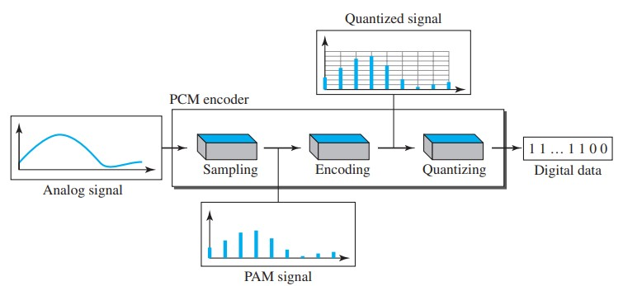
PULSE CODE MODULATION (CONTINUED)
1. The analog signal is sampled.
2. The sampled signal is quantized.
3. The quantized values are encoded as streams of bits

Slide 16
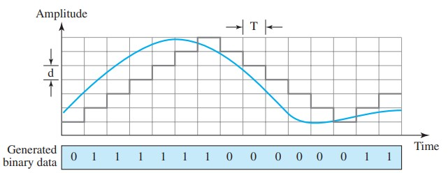
DELTA MODULATION
Delta Modulation (DM) is a simple form of analog-to-digital signal encoding.
It quantized the difference (delta) between the current sample and the previous one.
DM simplifies encoding by transmitting only the sign and size of the change in signal amplitude.
It is a type of differential pulse code modulation, providing a basic method for analog signal digitization.
While simple, DM may exhibit slope overload and granular noise issues in certain applications.

Slide 17
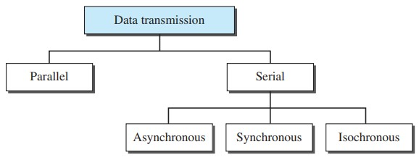
TRANSMISSION MODES
Transmission modes define the direction of data flow between sender and receiver.
Simplex mode allows data to flow only from sender to receiver.
Half-duplex mode enables bidirectional communication but not simultaneously.
Full-duplex mode allows simultaneous bidirectional communication.
These modes are crucial considerations in designing communication systems.

Slide 18
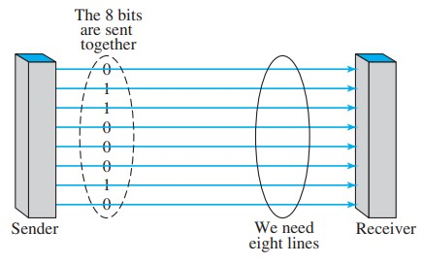
PARALLEL TRANSMISSION
Involves multiple data bits sent simultaneously over parallel channels.
Faster data transfer due to simultaneous transmission of bits.
Requires more physical wires or channels.

Slide 19
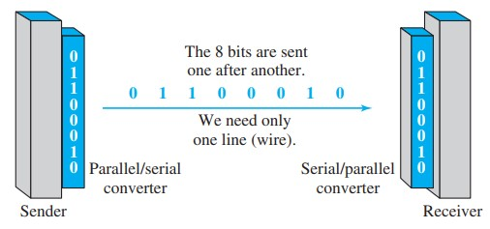
SERIAL TRANSMISSION
Involves sending one bit at a time over a single channel.
Simplifies wiring but may be slower compared to parallel transmission.
Commonly used in long-distance communication and with serial interfaces like USB and RS-232.

Slide 20
CONCLUSION
REFERENCE
Efficiency Boost:
Digital transmission enhances reliability and efficiency in computer networks.
Adaptive Modes:
Simplex, Half-Duplex, and Full-Duplex cater to diverse network communication needs.
Strategic Balance:
Choosing between parallel and serial transmission optimizes speed and simplicity for network performance.
Data-Communications-and-Network-5e by Forouzan
THANK YOU

